Slide 1
Infrastructure & Architecture
John Abbott (jabbott@us.ibm.com)
John Webb (john.webb@us.ibm.com)

Slide 2
Objectives
After completing this lecture, you will be able to:
Explain the IBM Cloud Private included components
Understand add-on components provided by IBM Cloud Private and their value
Have a foundation for diving deeper into specific areas of the solution

Slide 3
Agenda
Installation Scenarios
IBM Cloud Private – logical components
Network architecture
Storage considerations
Security
Scaling and sizing

Slide 4
Configuration topologies
Worker Node
Docker
Simple
Single machine install (master is a worker)
Great for testing and learning about the platform
Standard
Single master (single master, 3 workers, 1 proxy)
Great for non-production testing environment
High Availability
Multiple masters (3 masters, 3+ workers, 3 proxy)
Production installation
Pod
Pod
Pod
Container
Container
Container
Container
Container
Container
Master
Worker Node
Docker
Pod
Pod
Pod
Container
Container
Container
Container
Container
Container
Worker Node
Proxy Node
Docker
Pod
Pod
Pod
Container
Container
Container
Container
Container
Container

Slide 5
ICP – types of nodes
Boot node: A boot or bootstrap node is used for running installation, configuration, node scaling, and cluster updates. Only one boot node is required for any cluster. You can use a single node for both master and boot.
Master node: A master node provides management services and controls the worker nodes in a cluster. Master nodes host processes that are responsible for resource allocation, state maintenance, scheduling, and monitoring. Multiple master nodes are in a high availability (HA) environment to allow for failover if the leading master host fails. Host that can act as the master are called master candidates.
Worker node: A worker node is a node that provides a containerized environment for running tasks. As demands increase, more worker nodes can easily be added to your cluster to improve performance and efficiency. A cluster can contain any number of worker nodes, but a minimum of one worker node is required.
Proxy Node: A proxy node is a node that transmits external request to the services created inside your cluster. Multiple proxy nodes are deployed in a high availability (HA) environment to allow for failover if the leading proxy host fails. While you can use a single node as both master and proxy, it is best to use dedicated proxy nodes to reduce the load on the master node. A cluster must contain at least one proxy node if load balancing is required inside the cluster.

Slide 6
Installation overview
Container-based installer:
Download the installation container for CE or EE and execute the install
The installer pulls down additional containers from Docker Hub for CE, local repo for EE
Supported for RHEL and Ubuntu on X, POWER and Z (workers)
Basic installation steps:
1. Configure OS
2. Modify installation configuration files and run the installer
Overall installation should take < 4 hours depending on scenario
(90% System Config, 10% Installation)

Slide 7
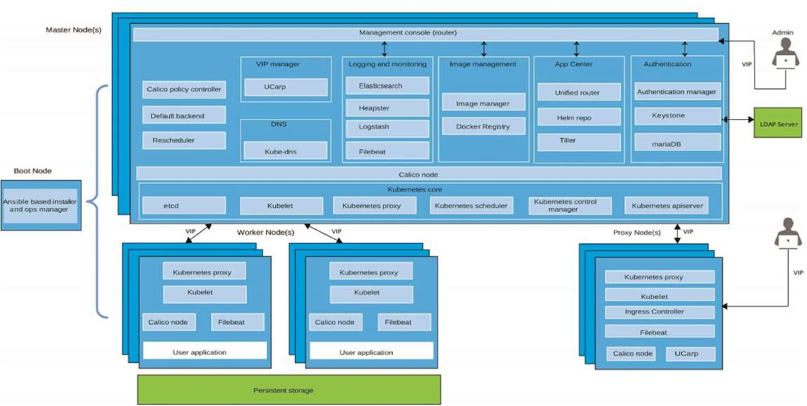
IBM Cloud Private – architecture components
Notes:
Go out and define each one of these components and maybe animate the whole thing
Need the slide source or completely rebuild slide with 2.1 changes

Slide 8
K8s master components
Master components provide the cluster’s control plane and global decisions about the cluster and detecting and responding to cluster events
Etcd: A strong, consistent, and highly-available key value store which Kubernetes uses for persistent storage of all of its API objects.
Kubelet: The primary “node agent” that runs on each node.
K8s Proxy: The Kubernetes network proxy runs on each node.
K8s Scheduler: A policy-rich, topology-aware, workload-specific function that significantly impacts availability, performance, and capacity.
K8s Control Manager: A daemon that embeds the core control loops shipped with K8s. In K8s, a controller is a control loop that watches the shared state of the cluster through the apiserver and makes changes attempting to move the current state towards the desired state.
K8s apiserver: Validates and configures data for the api objects which include pods, services, replication controllers, and others. The API Server services REST operations and provides the frontend to the cluster’s shared state through which all other components interact.

Slide 9
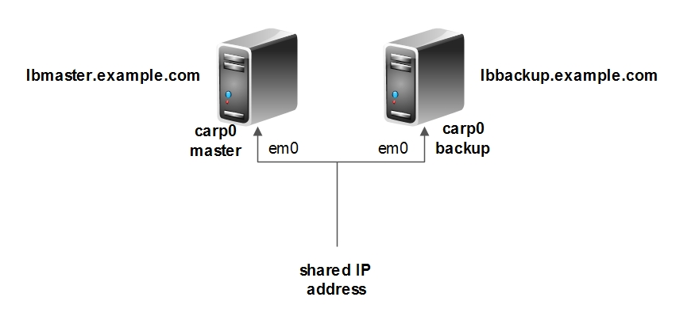
Network services components
DNS: (kube-dns, Cluster DNS) K8s DNS schedules a DNS pod and service on the cluster, and configures the kubelets to tell individual containers to use the DNS service’s IP to resolve DNS names. Every service defined in the cluster (including the DNS server itself) is assigned a DNS name. By default, a client pod’s DNS search list will include the pod’s own namespace and the cluster’s default domain.
VIP and UCarp: UCarp allows a couple of hosts to share common virtual IP (or floating IP) addresses in order to provide automatic failover.

Slide 10

Calico
A new approach to virtual networking and network security for containers, VMs, and bare metal services, that provides a rich set of security enforcement capabilities running on top of a highly scalable and efficient virtual network
The calico/node Docker container runs on the Kubernetes master and each Kubernetes node in the cluster
The calico-cni plug-in integrates directly with the Kubernetes kubelet process on each node to discover which pods have been created, and adds them to Calico networking
The calico/kube-policy-controller container runs as a pod on top of Kubernetes and implements the NetworkPolicy API
Notes:
Pure layer 3 cloud networking solution
Distribute routes using BGP protocol, with route reflectors for scale
Leverage linux kernel’s efficient IP forwarding engine
Translate global policy into distributed firewall on each host, enabling tenant isolation

Slide 11
Ingress resources
Ingress: Typically, services and pods have IPs only routable by the cluster network. All traffic that ends up at an edge router is either dropped or forwarded elsewhere.
An Ingress is a collection of rules that allow inbound connections to reach the cluster services.
It can be configured to give services externally-reachable URLs, load balance traffic, terminate SSL, offer name based virtual hosting etc.
Users request ingress by POSTing the Ingress resource to the API server
Ingress Controller: Responsible for fulfilling the Ingress, usually with a load balancer, though it may also configure your edge router or additional frontends to help handle the traffic in an HA manner.
Notes:
Could use a picture

Slide 12
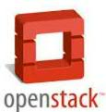
Authentication components
Authentication Manager: Provides an HTTP API for managing users. Protocols are implemented in a RESTful manner. Keystone is used for authentication. Pass-through is used for external LDAP integration.
Keystone: The OpenStack provided identity service currently supporting token-based authN and user-service authorization.
MariaDB: An open source relational database made by the original developers of MySQL. In this case it is used to back-end Keystone.
Authentication Service
LDAP
Authorize
System
Services
ID Token
Request $ ID Token
kubernetes
Image manager
mesos
UI
Notes:
Rework this pic
Based on OpenID connect protocol
OpenStack Keystone as the backend
User/Tenant management
Integrate with LDAP

Slide 13
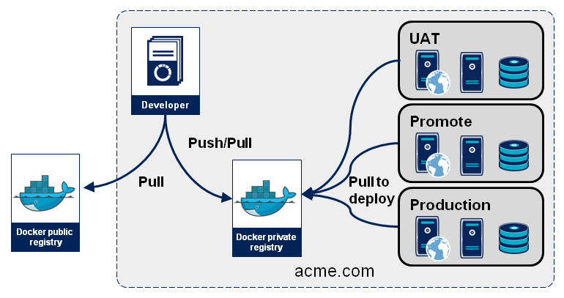
Images and Registries
You create a Docker image and push it to a registry before referring to it in a Kubernetes pod
There will likely be many registries used in your deployment
Notes:
Rework this with public and private registries

Slide 14
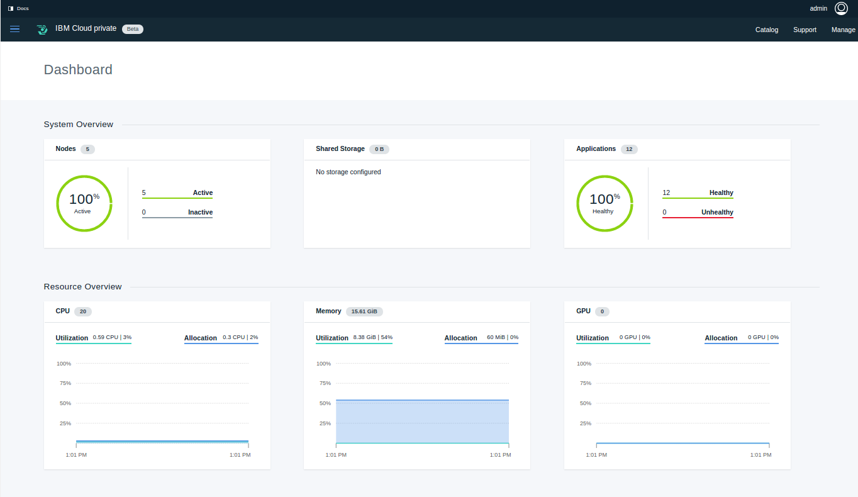
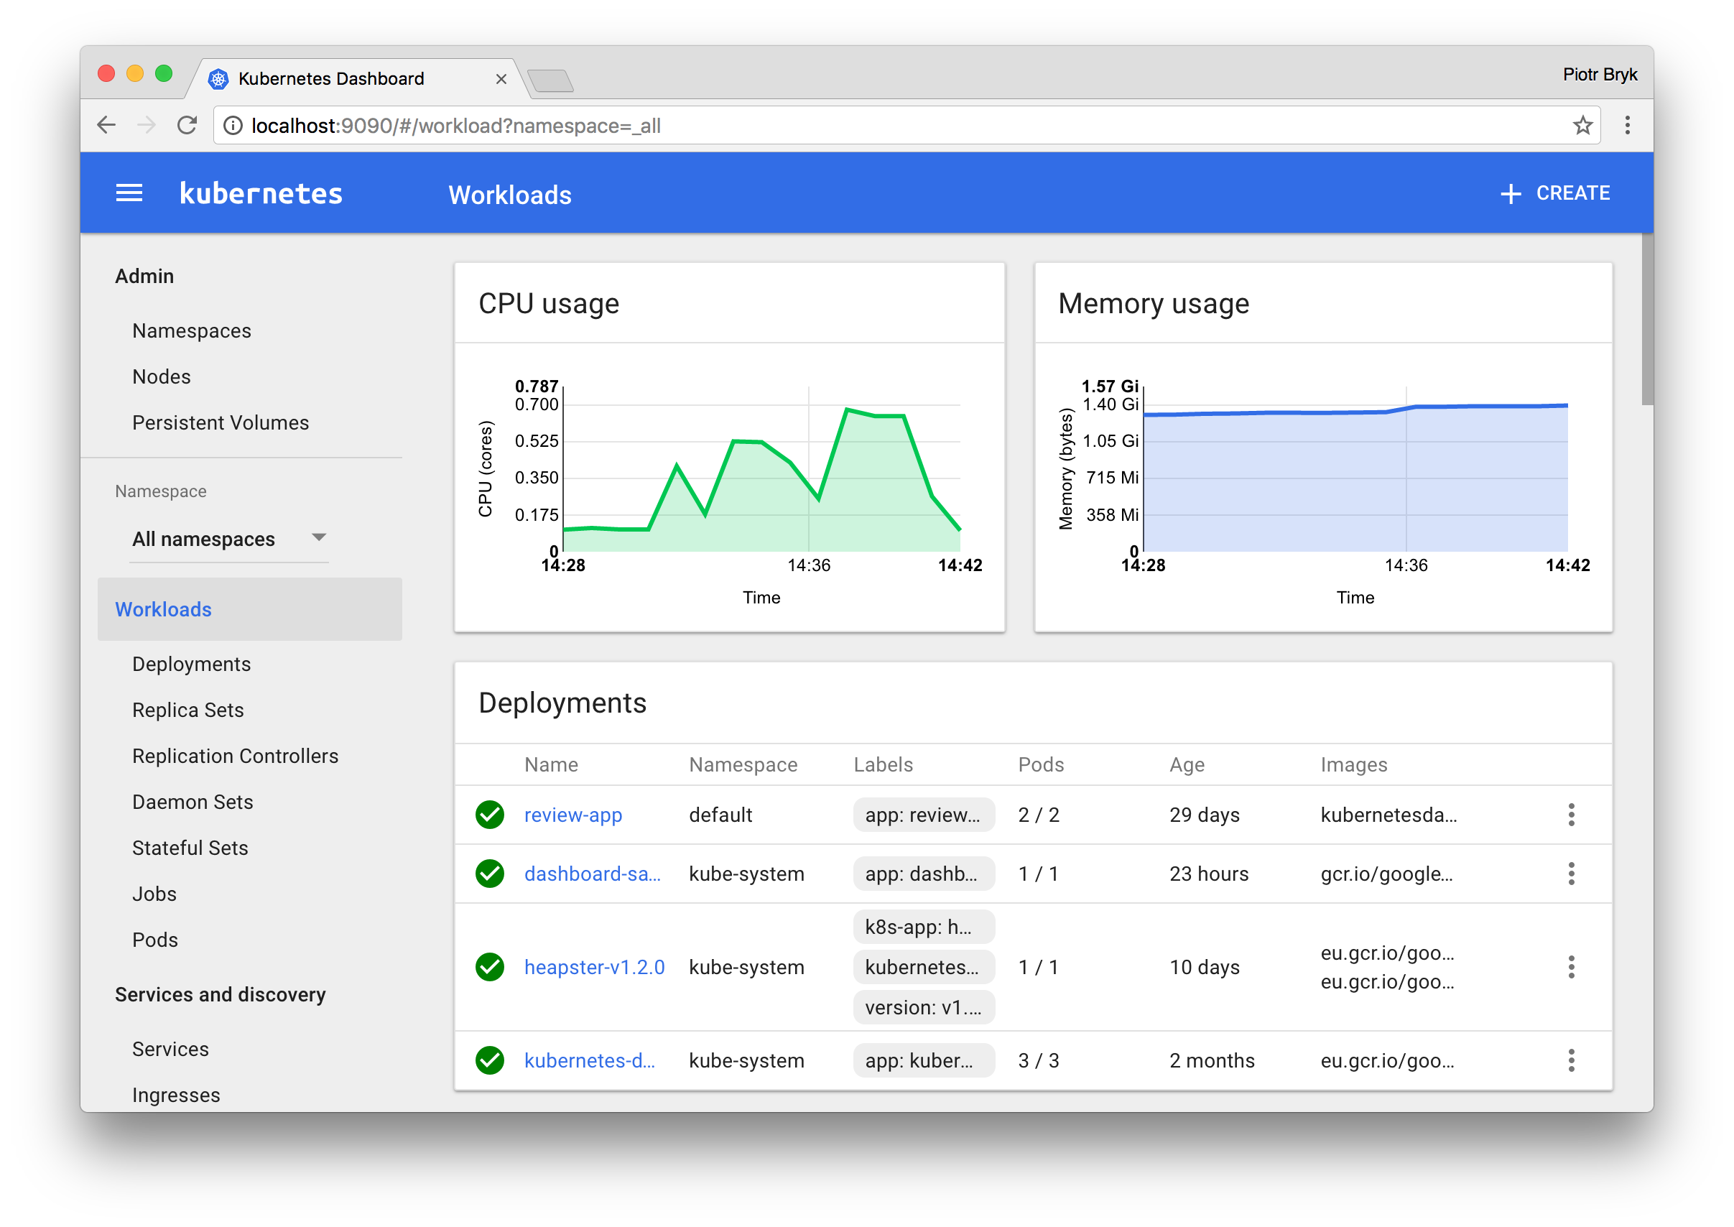
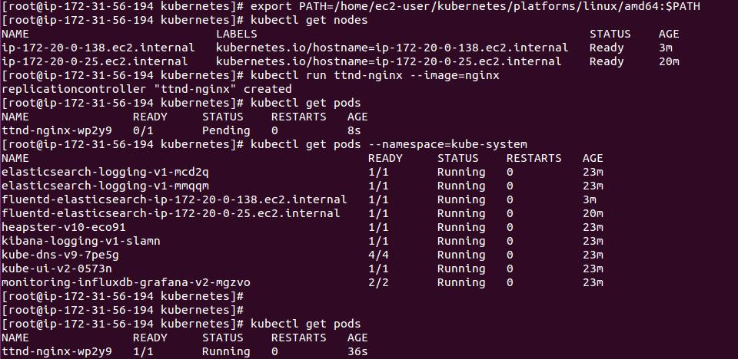
User Interfaces
Cluster Management Console: (ICP component) Use to manage, monitor, and troubleshoot your applications and cluster from a single, centralized, and secure management console.
K8s Web UI: Can use to deploy containerized applications to a Kubernetes cluster, troubleshoot your containerized application, and manage the cluster itself along with its attendant resources.
kubectl: A command-line interface for running commands against Kubernetes clusters.

Slide 15
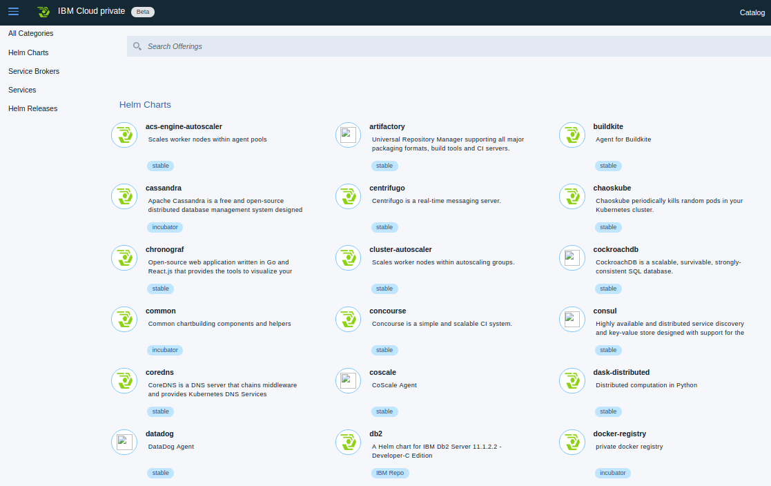
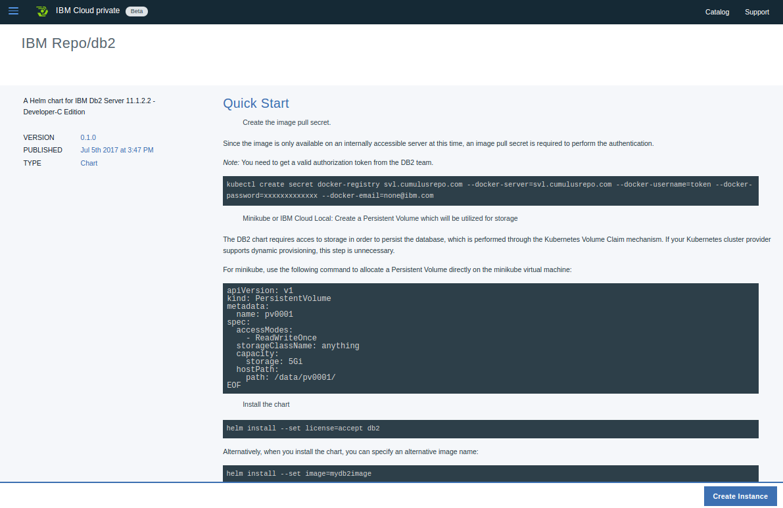
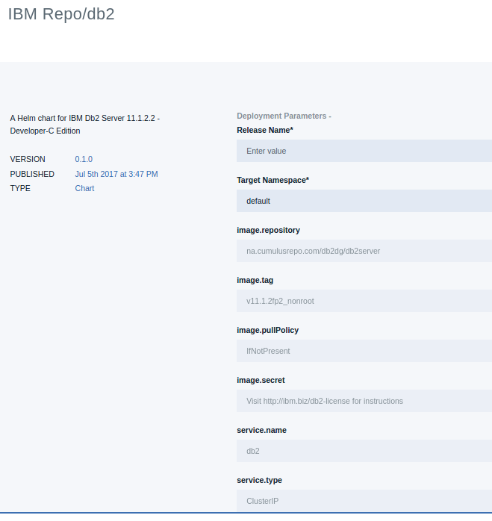
Application Center components
Application center provides a centralized location from which you can browse, and install packages in your cluster.
Helm: A tool for managing Kubernetes charts. Charts are packages of pre-configured Kubernetes resources.
Helm Repository: A Helm chart repository is a location where packaged charts can be stored and shared.
Tiller: Runs inside of the cluster, and manages releases (installations) of your charts.

Slide 16
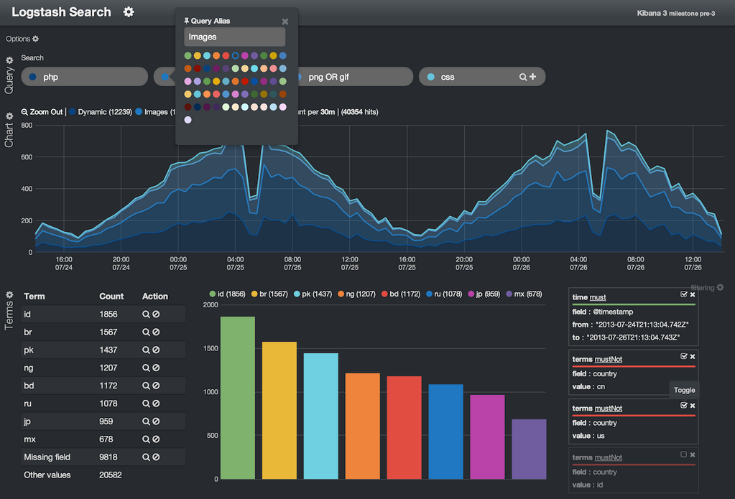
Logging components
The easiest and most embraced logging method for containerized applications is to write to standard out and standard error
Filebeat: A log data shipper for local files. Filebeat monitors the log directories or specific log files, tails the files, and forwards them either to Elasticsearch and/or Logstash for indexing.
Elasticsearch: An open source full-text search engine based on Lucene. It provides HTTP web interface and schema-free JSON documents.
Logstash: A open source tool for collecting, parsing, and storing logs for future use.
Heapster: The Kubernetes network proxy runs on each node.
Kibana: An open source data visualization plugin for Elasticsearch. Users can create bar, line and scatter plots, or pie charts and maps on top of large volumes of data.
Notes:
ElasticSearch
Shared, replicated, searchable, json document store
Full text search, geo spatial search, advanced search ranking, suggestion, … much more.
Nice HTTP API
Logstash
Tool for receiving, processing, and outputting logs.
Indexing logs in Elasticsearch
Filebeat
Golang: Easy deployment...download executable
Focuces: Only minimal processing
Efficient: Small memory footprint
Heapster
Container Cluster Monitoring and Performance Analysis
Collects and interprets various signals like compute resource usage, lifecycle events, etc, and exports cluster metrics via rest endpoints.
Supports multiple storage backend.
Elasticsearch
InfluxDB
Kafka
Goggle Cloud Logging

Slide 17
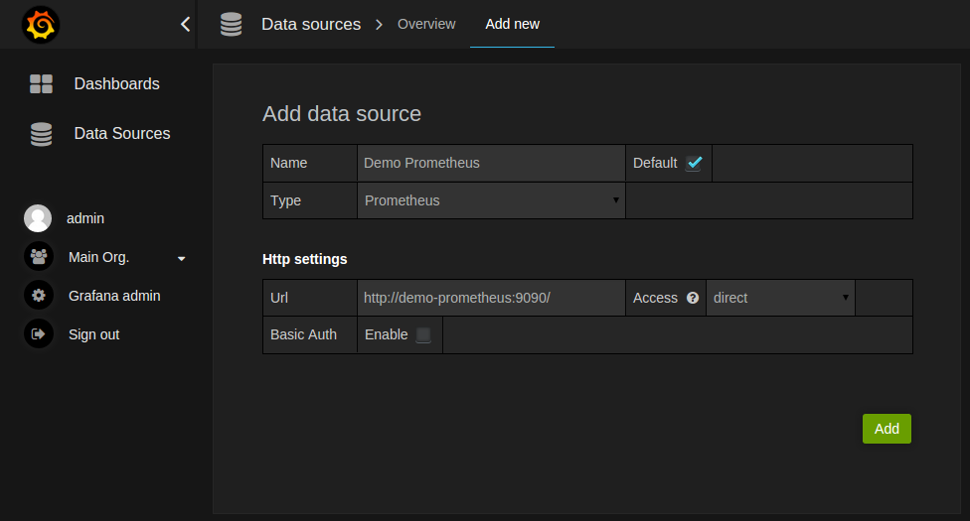
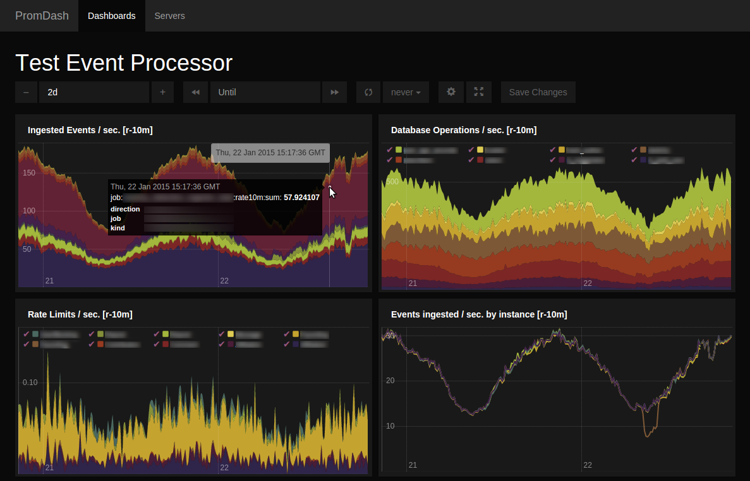
Monitoring: Prometheus and Grafana
Prometheus: An open-source systems monitoring and alerting toolkit originally built at SoundCloud. Since its inception in 2012, many companies and organizations have adopted Prometheus, and the project has a very active developer and user community. It is now a standalone open source project and maintained independently of any company.
Grifana: An open-source, general purpose dashboard and graph composer, which runs as a web application.

Slide 18
Persistent storage components (1 of 2)
Traditionally Containers: stateless, ephemeral in nature
Storage exists within the container
The container goes away and so goes the storage
Some applications desire state and thus persistent storage:
Specific aspects of configuration
Database (structured and unstructured)
Application data (website definitions, etc.)
Storage must be universally accessible across the K8s environment

Slide 19
Persistent storage components (2 of 2)
ICP Persistent Storage Support: HostPath, NFS, GlusterFS, vSphereVolume
Note: Reclaim policy and access modes and behaviors can vary
Access Modes:
ReadWriteOnce – the volume can be mounted as read-write by a single node
ReadOnlyMany – the volume can be mounted read-only by many nodes
ReadWriteMany – the volume can be mounted as read-write by many nodes
Notes:
Other popular providers not in support
CephFS
Google (GCE PersistentDisk)
AWS (ElasticBlockStore)
Azure (Azurefile, AzureDisk)
Cinder
FC
FlexVolume
Flocker
iSCSI
Quobyte
VspherVolume
Etc.

Slide 20

GlusterFS
Network Attached Storage
POSIX-Compliant distributed file-system
Differentiator -> No central metadata server
Aggregator of storage and metadata
Flexible scaling for capacity and performance
NOTE: Red Hat Gluster Storage (formerly Red Hat Storage Server) is built upon the open source GlusterFS at gluster.org
Notes:
Portable Operating System Interface IEEE standard
Heterogeneous Commodity Hardware
Typical NAS has limited scalability and when they do they include metadata servers that tend to become a bottleneck
SAN obviously scales at a price

Slide 21
GlusterFS and Heketi
Heketi
Restful management interface for the management of GlusterFS volumes
For Kubernetes, it provides dynamic provisioning of volumes
You provide nodes with storage devices
Heketi assembles the topology
Manages life-cycle of bricks, volumes, etc
ICP + K8s Talk to Heketi
https://github.com/heketi/heketi
Trusted
Storage
Pool
Gluster:Node 1
Accept
Gluster:Node 2
Probe
Probe
Gluster:Node X
Accept

Slide 22
GlusterFS - common deployment architecture
K8s: Master Node
Pod-ased Components
Gluster pods Deployed to each K8s node
Heketi pod or pods deployed to K8s
Gluster Provisioner
K8s: Worker Node
K8s: Worker Node
App Pod
Heketi Pod
Heketi Pod
Gluster Mount Plugin
Storage Device
Gluster Pod (Daemon Set)
Storage Device
Gluster Pod (Daemon Set)
K8s: Worker Node
Heketi Pod
Storage Device
Gluster Pod (Daemon Set)

Slide 23
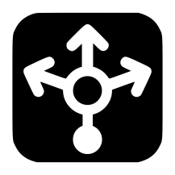
Enterprise architecture
ICP Cluster
Principle: Remove management and back-end from the platform
Heketi can be installed as pods or on HA IaaS
Allows storage solution life-cycle outside of ICP
K8s: Worker Node
K8s: Master Node
Heketi
App Pod
App Pod
Heketi
Heketi
Gluster Mount Plugin
Gluster Provisioner
Gluster Cluster
Gluster Node
Storage Device
K8s: Worker Node
K8s: Worker Node
Storage Device
Storage Device
Storage Device
Storage Device
Gluster Node
Gluster Node

Slide 24

GluserFS architecture extended (example)
Gluster cluster (trusted storage pool) serving one or more ICP cluster in the same data center
Geo replication replicates data to remote GlusterFS node (one way)
One ICP may access one or more GlusterFS trusted storage pools
Asia
Data Center
ICp Cluster
ICp Cluster
ICp Cluster
Heketi
Gluster Cluster
US
Data Center
Heketi
Gluster Cluster
ICp Cluster
ICp Cluster
Node
Gluster Cluster
Node
Node
Node
EU
Data Center
Node
Node
Node
ICp Cluster
ICp Cluster
Gluster Cluster
Node
Heketi

Slide 25
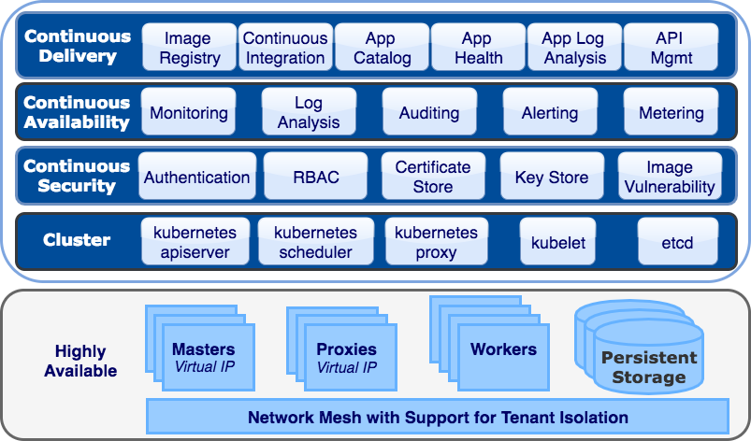
ICP Functional Architecture
Services marked in red could not be contained for October.
Notes:
Need to recreate this or find source
This is to review the overall architecture … maybe with audience participation

Slide 26
Supported system configurations (October Release)
Looking into RHEL 7.4 support
OS/Browsers:
Target to test latest 1-2 stable, supported versions as of 2 months prior to GA
Specs |  | Support Statement
OS | x86 | RHEL 7.1, 7.2, 7.3, Ubuntu 16.04 LTS
 | Power | RHEL 7.1, 7.2, 7.3, Ubuntu 16.04 LTS
 | Z (workers) | RHEL 7.1, 7.2, 7.3, Ubuntu 16.04 LTS; deployed as zVM, zKVM or LPAR
Browsers | Windows | IE 11, Firefox 52.x, 53, ESR 52.x, Chrome 59.0.3071.115
 | Linux | Firefox 44, 45, 52, 53, ESR 38, ESR45, ESR 52.x
 | MacOS | Safari 9.0.1, 10.x, Firefox 53, ESR 52.x, Chrome 59.0.3071.115
Docker | x86 | 17.03-ce (included in ICp) | Or customer installed: 1.12, 1.13, CE & EE 17.03-ce, 17.06
 | Power | 17.03-ce (included in ICp) | Or customer installed: 1.12, 1.13, CE & EE 17.03-ce, 17.06
 | Z (workers) | 17.03-ce (included in ICp) | Or customer installed: 1.12
Storage |  | Built-in storage options: GlusterFS + Heketi, vSphere vVol External data stores: NFS 4, Gluster FS 3.5.9, Spectrum Scale (via NFS or Hostpath) + all Kubernetes supported storage types
Networking |  | Calico (default), NSX-T 2.0 (optional)

Slide 27
Size & scale (October Release)
Specs |  | Support Statement
Node specs (minimum) | Master | 2 cores @2.4 GHz, 4 8 GB RAM, 6 40 GB Disk
 | Worker | 1 core @2.4 GHz, 4 GB RAM, 6 40 GB Disk
# of Nodes (PM or VM) | Minimum | 1 (single node install supported)
 | Maximum | 60 300 Power nodes, 300 x86 nodes (tested limits, not hard limits)
# of Pods |  | 2000 9000 (tested limit)
# of Users |  | 10000 (tested limit, not hard limit)

Slide 28
Supporting Material

Slide 29
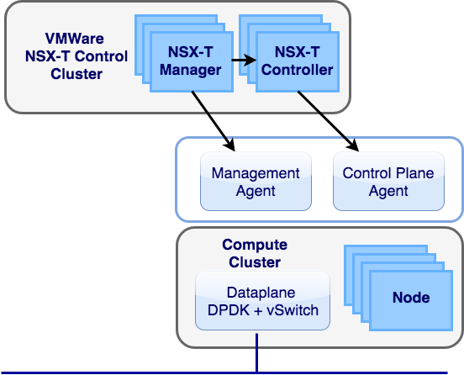
VMWare NSX-T Integration
NSX-T offers a new way to define networking on VMWare environments that offers flat networking between containers and virtual machines

Slide 30
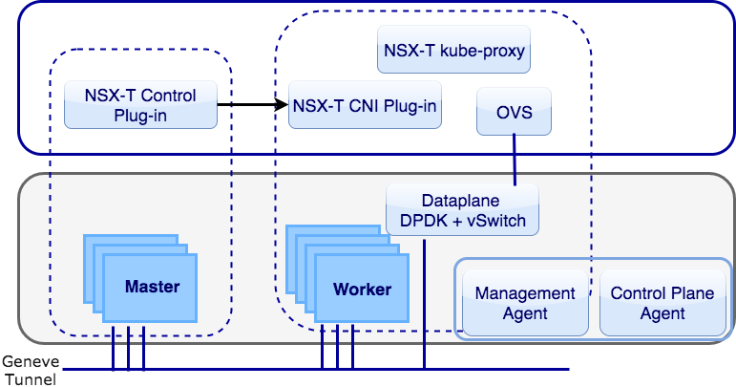
VMWare NSX-T Integration
IBM Cloud private will offer NSX-T as the networking mesh between pods on VMWare ESXi 6.5
Calico will continue to be used in OpenStack and lower versions of VMWare (down to ESXi 5.5)

Slide 31
System z Support
ICp 2.1 will support running worker nodes on z hardware (including z14) running Ubuntu 16.04 LTS and RHEL VMs.
The management components (master, proxy, boot nodes) are not yet supported on z. These can be run on x86_64 or Power Linux based hardware.
Does not include the Cloud Foundry option, only the Kubernetes features are supported on z workers
Does not support zOS, only Linux on z running on zVM, zKVM or z LPAR.

Slide 32
End-to-End Hybrid Architecture

Slide 33
This presentation is intended for an IBM internal audience only.

